Slide 1

Chapter 12: Wave properties
Bishop Stopford School
faith | justice | responsibility | truth | compassion
All work to be done in your exercise book. If you run out of space, start another book.
Print out all worksheets. If you don’t have a printer, write answers in your book using FULL sentences.
ONLINE LEARNING
Print off specification sheet from:
https://bishopstopford.fireflycloud.net/science-2/school-closure-tasks/year-10-1/physics/triple-1/p12-wave-properties

Slide 2
P12 Lessons 1 and 2: The nature and properties of waves
Week 1 (20th April to 26th April)
Year 10
Triple physics

Slide 3
Learning objectives
Describe what a transverse and longitudinal wave is with examples.
Define amplitude, frequency, wavelength and period of a wave.
Calculations using the wave equation.

Slide 4
Retrieval
Write down 3 types of waves you have heard of.
What do you think all waves transfer?

Slide 5
Retrieval: Possible answers
Water waves, electromagnetic waves, sound, mechanical wave, transverse wave, longitudinal wave
All waves transfer energy

Slide 6
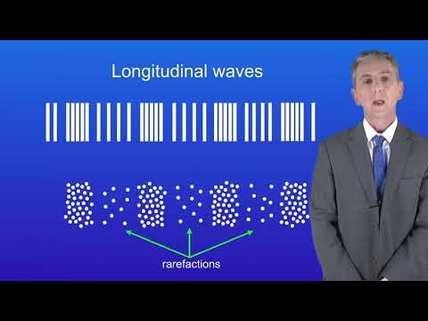
Acquire – watch the video
Make notes.
Pause or re-watch the video if necessary

Slide 7
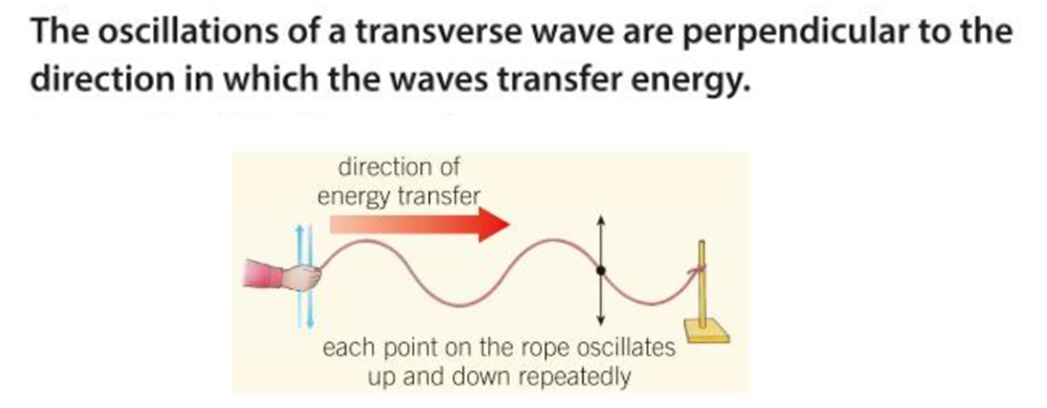
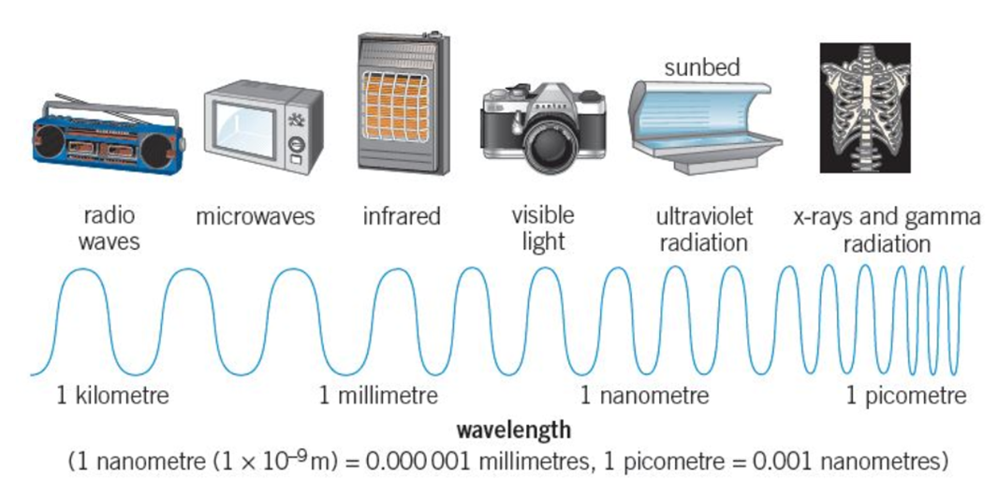
Acquire – transverse waves
All electromagnetic waves are transverse
Waves transfer energy.
However, the medium the wave is travelling in does not move. The particles in the medium oscillate to and fro or up and down.

Slide 8
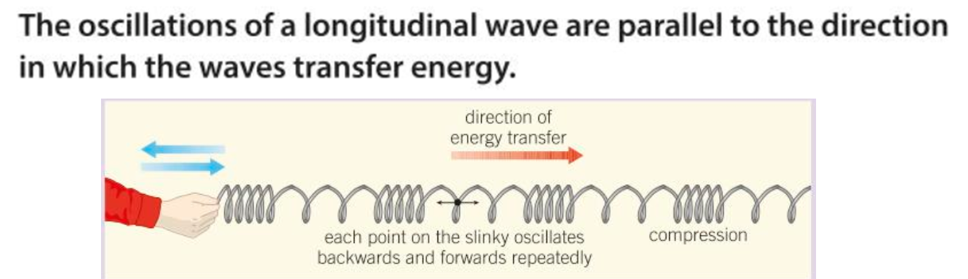

Acquire – longitudinal waves
Sound is a longitudinal wave. the air particles vibrate back and forth passing on their energy to neighbouring particles, which also start vibrating back and forth, and so on. Eventually the sound waves move from the source and towards a detector, like the ear!

Slide 9
Acquire – Mechanical waves
These are vibrations that travel through a substance. They can be transverse or longitudinal.
A transverse wave on a string or a water wave are mechanical waves.
Electromagnetic waves are transverse, but NOT mechanical because they can travel in a vacuum and do not need a medium.
Sound waves are longitudinal and mechanical because they need air particles to travel through.
Seismic waves produced by earthquakes are mechanical and transverse (S waves) or mechanical and longitudinal (P waves)

Slide 10
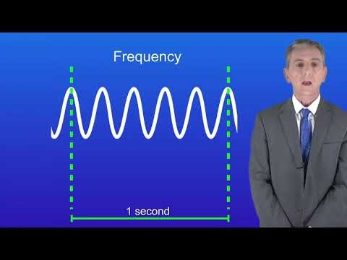
Acquire - watch the video
Make notes.
Pause or re-watch the video if necessary

Slide 11
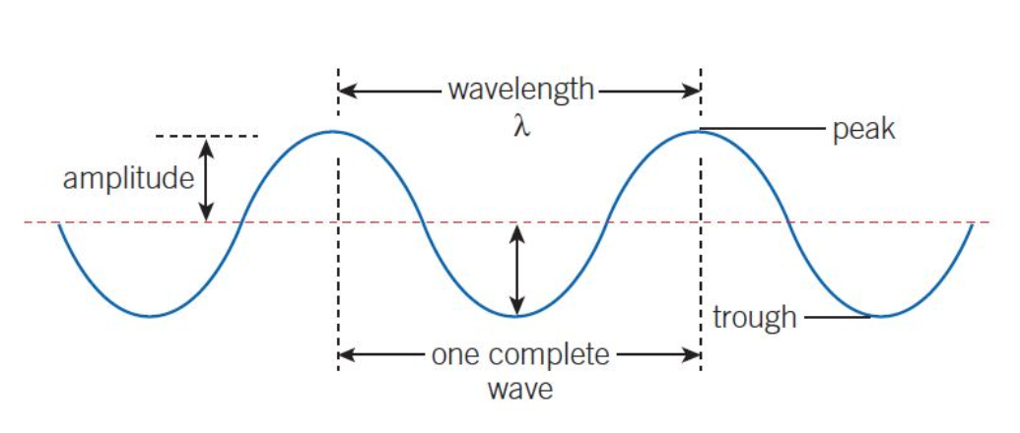
Acquire – parts of a wave

Slide 12
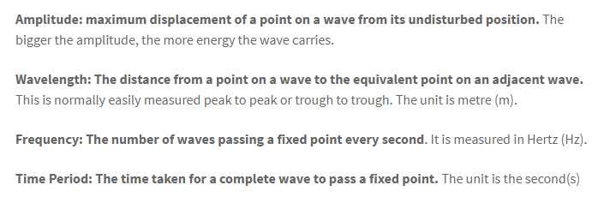
Acquire – definitions

Slide 13
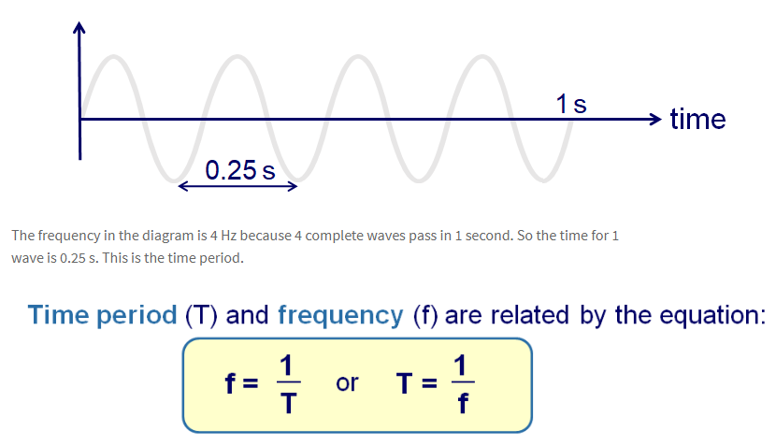
Acquire – frequency and time period

Slide 14
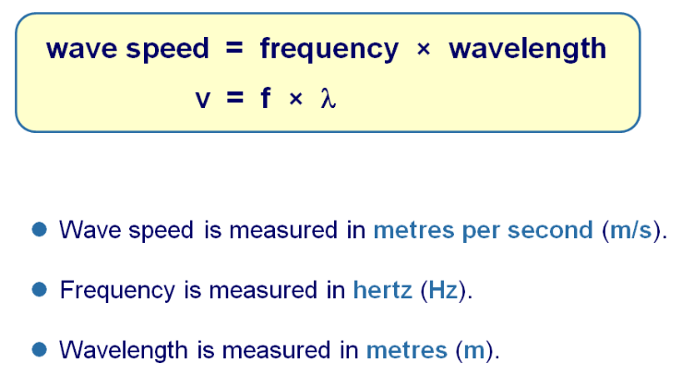
Acquire – the wave equation
https://youtu.be/Aucu7YshyQ0

Slide 15
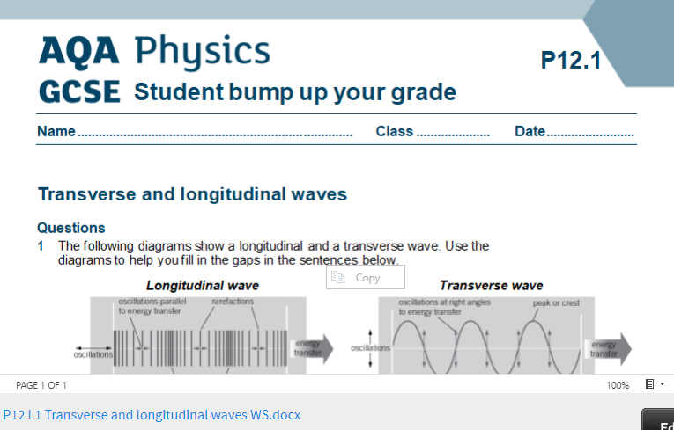
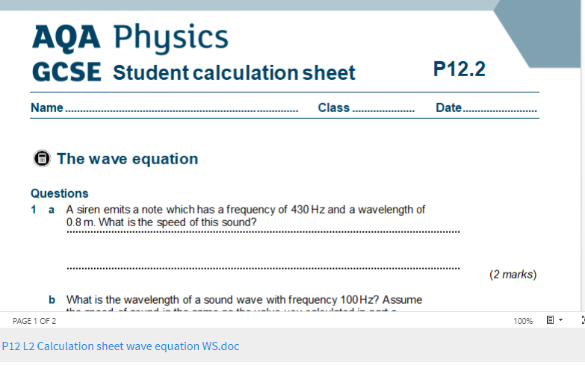
Action – 2 worksheets
Access and print 2 pages per side from:
https://bishopstopford.fireflycloud.net/science-2/school-closure-tasks/year-10-1/physics/triple-1/p12-wave-properties
If you don’t have a printer, write full sentences in your book.

Slide 16
Review
1. Define the following:
Transverse wave
Longitudinal wave
Amplitude
Frequency
Wavelength
Time period
2. What is the wave equation?

Slide 17
Review – can you….
Describe what a transverse and longitudinal wave is with examples?
Define amplitude, frequency, wavelength and period of a wave?
Use the wave equation in calculations?

Slide 18

Dig deeper (optional)
There is no sound in space or is there?
Research gravitational waves. Write no more than one side in your exercise book based on your findings.
You may use these links if you wish:
https://www.ligo.caltech.edu/page/what-are-gw
https://www.forbes.com/sites/startswithabang/2017/05/03/there-is-sound-in-space-thanks-to-gravitational-waves/#374fd9d74049

